Slide 1
HOTEL RECOMMENDATIONS USING PAST ENTRIES
Submitted By:
Sakshi Mahashabde(0157CS181134)

Slide 2
PROJECT DESCRIPTION
The project provides personalized hotel recommendations to their users. With hundreds, even thousands, of hotels to choose from at every destination, its difficult to know which will suit your personal preferences. We plan to recommend hotels to users based on their booking history and search preferences.
it's difficult to know which will suit your personal preferences.
We plan to recommend hotels to users based on their booking history and search preferences.
With hundreds, even thousands, of hotels to choose from at every destination, it's difficult to know which will suit your personal preferences.
We plan to recommend hotels to users based on their booking history and search preferences.

Slide 3
DATA SOURCES
The given dataset consists of three input sets:
1.Users.txt- It has user’s features, user id , gender and continent.
2. Activity.txt- It has user id of user and hotel selected by user.
3. Hotel.txt- It has hotel number and rating.

Slide 4
TECHNOLOGIES USED
Machine learning algorithms like KNN, Random Forest and XG Boost
Programming language – Python 3.9.1
Libraries- Pandas, Numpy, Matplotlib
Tools- Jupyter Notebook

Slide 5
WHAT IS A RECOMMENDER SYSTEM?
Recommender systems are a subclass of information filtering system that seek to predict the "rating" or "preference" that a user would give to an item.
Recommender systems identify recommendations autonomously for individual users based on past purchases and searches, and on other users' behavior.

Slide 6
TYPES OF RECOMMENDER SYSTEM
Content- based systems examine properties of the items recommended. Eg. If a Netflix user has watched many cowboy movies, then recommend a classified in the database as having cowboy.
Collaborative filtering systems recommend items based on similarity measures between users and items. The items recommended to a user are those preferred by similar users.

Slide 7
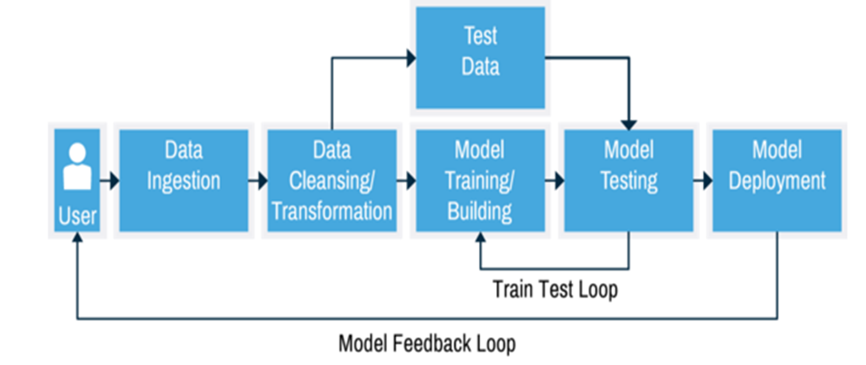
PROJECT OVERFLOW

Slide 8
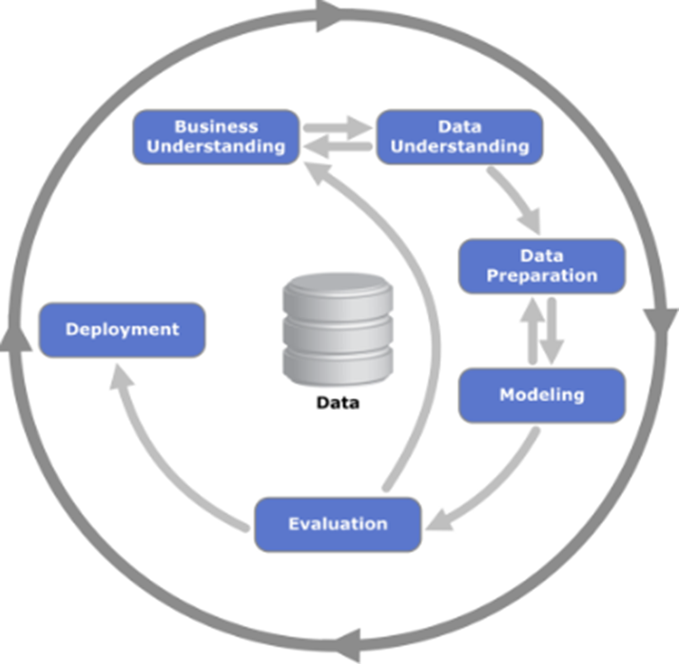
PROCESS OVERVIEW
Data mining model used:
Business understanding
Data understanding
Data Preparation
Modelling
Evaluation
Deployment

Slide 9
DATA UNDERSTANDING
Explored the dataset which was structured.
Understood the datatypes, their meaning and importance.
Helps user find a hotel catering to their needs and requirements.

Slide 10
DATA PREPARATION
Implemented feature based filter selection technique. Output consisted of top 5 hotel clusters for each user.

Slide 11
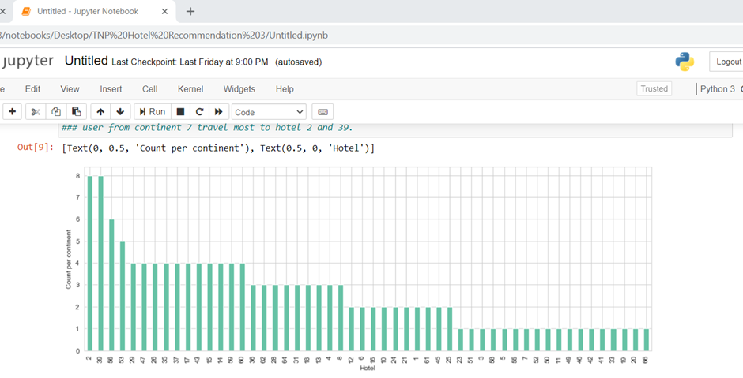
MODELLING
In this we had used two approaches:
Rule- based approach- As we could see gender didn’t play any role in determining the famous hotels. So one approach to test frequency per continent results has also been done.
As Data is low in parameters, plus the data entries is also not enough, its better to go for Non-Parametric Equation as parametric one might overfit. So, We can think of KNN, Decision Trees(Random Forest, XGBOOST). Upon Experimenting with KNN, I realised that it was giving good results, if there was no constraint on repetition. But not so well for non-repetition.

Slide 12
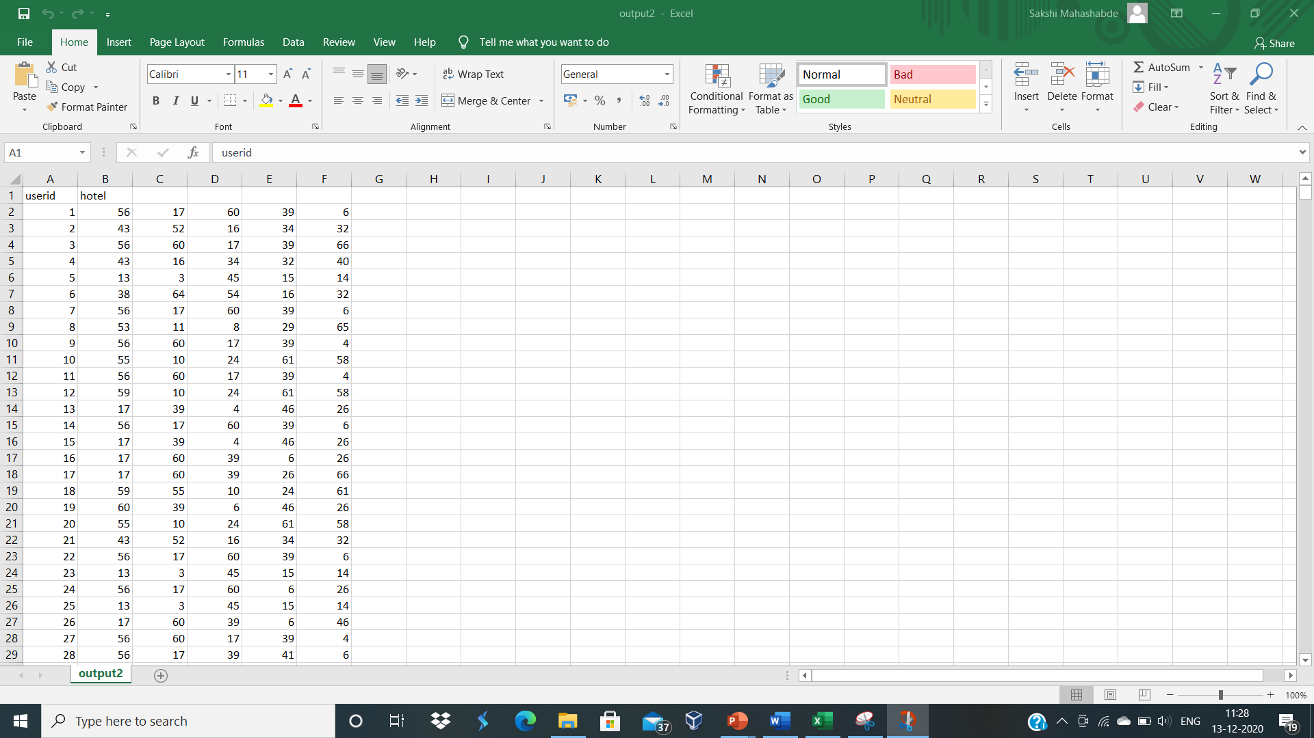
OUTPUT
As we can see in the output we have recommended 5 hotel clusters for each user id. There were about 4500 users for which our hotel recommender has recommended hotels.

Slide 13
THANK YOU

